Slide 1
Supporting Inferences Using Text Evidence Ms. Rodgers 4th Grade ELA Date: 3.25.20

Slide 2
Question?
When was the last time you made an inference?
You might ask: What’s an inference?
Inference: Making a “reasonable guess” using details and examples, as well as, what you already know.
Evidence + My Experience = My Inference

Slide 3
Today scholars will focus on standards: (RL.KID.1)(RI.KID.1) SWBAT refer to details and examples in the text “The Penny Thief” IOT explain what the text says explicitly. and SWBAT refer to details and examples in this text IOT draw inferences from the text. Vocabulary Dive: explicitly: what the text plainly states
Notes:
Decode highlighted portion of standards so scholars understand exactly what they are to master

Slide 4
Materials Needed for this Lesson
Paper
Pencil (jot down notes or questions and draw inference chart)
Listening Ears
Focus

Slide 5
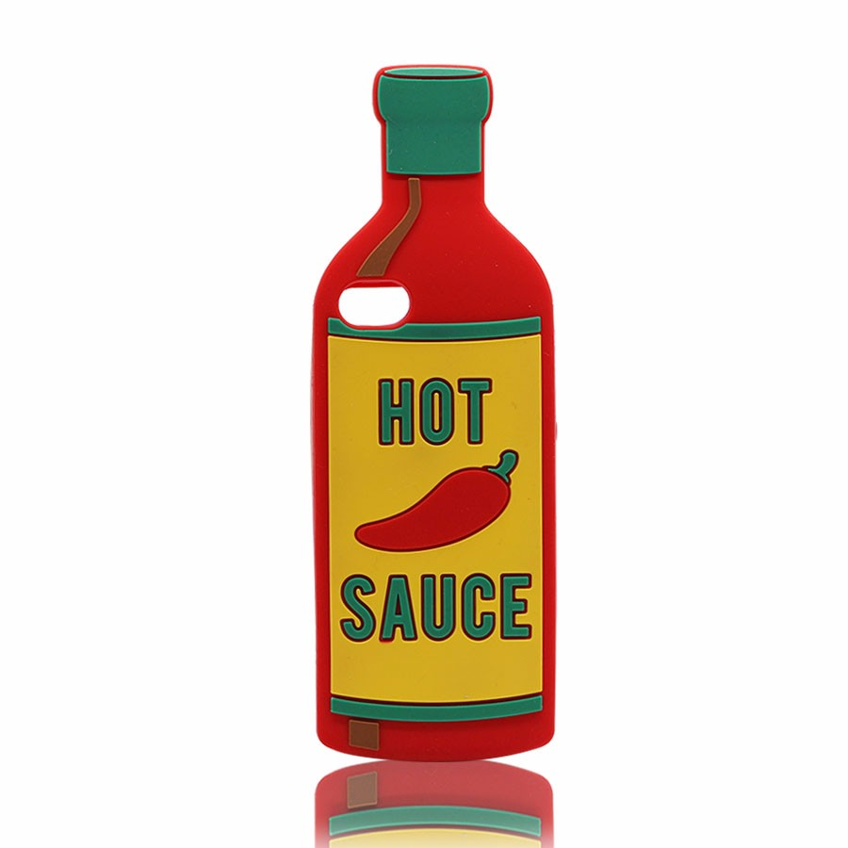
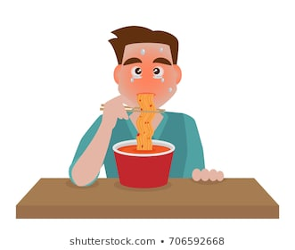
Opening: Making an Inference Teacher Model
Evidence
My Experience
(what I Already Know)
My Inference
I can infer the boy added too much hot sauce to his food.
Notes:
Describe Pic 1 – eating, face is red, sweating, eyes are becoming red What do you already know about hot sauce Support inference with evidence

Slide 6
Work Time: Refer to Details and Examples to Support an Inference
Anchor Text:
The Penny Thief
By Charlotte Fairchild
Explore: Think about what details in the text you will use to help support your inference..

Slide 7
“The Penny Thief” by Charlotte Fairchild 1 My family got a parakeet on the very day that we moved into our new apartment. On our first night in the new place, we tried to name our new pet. I wanted to call it Tweetie, but no one else liked that name. We couldn’t find a name that everyone agreed on, so we agreed to think about it for a while. 2 My father always emptied his pocket change into a large glass bowl in the hallway. When we wanted money for this or that, he would count it out for us from the bowl. The very next night, as he tossed his change into the bowl he mumbled, “Funny! I’m sure there were mostly pennies on top.” None of us knew where the pennies had gone. 3 Every day that week, my father complained that someone was taking pennies from his bowl. We all pleaded ignorance. And every day that week, we discussed a new name for our pet. 4 At the end of the week, we took everything out of the birdcage to clean it. In every corner of the cage was a pile of pennies. That’s when we learned that my mother had let the bird out to fly around every morning. “Penny thief!” my father cried. And our pet was named on the spot. Source: Ready (Reading Instruction 4)
Notes:
Why doesn’t the parakeet have a name? What does dad notice about the bowl of coins? What does the word ignorance mean? What details from the text help you to figure out the meaning? What is the text mostly about?

Slide 8
Written Response
Let’s re-read paragraph 3! Think about the father’s action. Then write a 2-3 sentence response describing an inference you can make about his actions. Since we are trying to master the skill of inferring, challenge yourself to use the academic vocabulary word “infer” in your writing.
I can infer that the father was extremely upset about his missing pennies, because he complained all week. I know when people complain, they are not happy.
Notes:
For example you might say I can infer…..

Slide 9
Work Time: The Penny Thief Supporting My Inferences Using Details and Examples from the Text
Evidence from Text | My Experience | My Inference
 |  | The family wants to know what is happening.
 | Some birds are attracted to shiny objects.
Notes:
“None of us knew where the pennies had gone.” I know when money is missing, people (including me) want to figure out where it is.
“…mother had let the bird out to fly around every morning.” “In every corner of the cage was a pile of pennies. I can infer that the bird saw the pennies and picked them to take them back to his cage.

Slide 10
Closing: Review Explore: Think about what details in the text you will use to help support your inference.
Part A
Part B
Explore: What key detail from this lesson helped you to make a reasonable guess about who the penny thief was?
The family got a parakeet the same day they moved into the apartment.
The family did not know where the missing pennies were.
What I knew about some birds being attracted to shiny objects.
The family wanted to wait on a new name for the pet.
Choose evidence from the text to help support your answer in Part A.
“None of us knew where the pennies had gone.”
“We couldn’t find a name that everyone agreed on, so we agreed to think about it a while.”
“In every corner of the cage was a pile of pennies.”
“My family got a parakeet on the very day that we moved into our new apartment.”

Slide 11
Check for Understanding: Did you master it? Review Learning Targets
RL.KID.1)(RI.KID.1) SWBAT refer to details and examples in the text “The Penny Thief” IOT explain what the text says explicitly. and SWBAT refer to details and examples in this text IOT draw inferences from the text.

Slide 12
Well my friends we have come to end of this lesson, but hopefully not at the end your learning. Although during these times we are not learning in the classroom, your learning should not stop. Use all the resources you have available to keep your creative brain flowing. Stay positive, focus, and fearless because based on the evidence and what I know, I can infer that these times won’t last forever. Until next time keep calm and keep learning!

