Slide 1
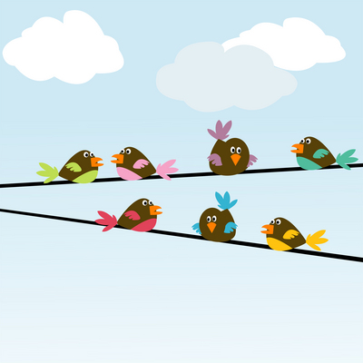
Making Inferences
Reading Between the Lines

Slide 2
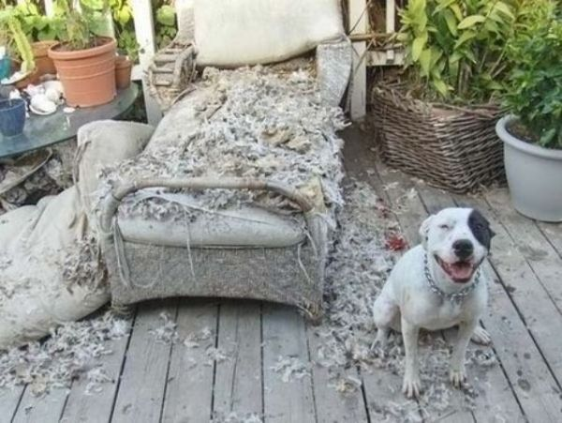
What is Inference?
You get home, and this is what you see.
What do you think happened?

Slide 3
What is Inference?
Copy this definition:
Making Inferences – the process of making logical guesses based on evidence and personal knowledge or experience.
Inference
The dog in the picture chewed the chair cushion.
Evidence:
Chair cushion is torn up.
Dog is sitting nearby.
No one else is around.
Personal Knowledge
or Experience
I have a dog.
My dog chewed up a toy one time and the damage looked similar.

Slide 4
Guided Practice
What inference can you make based on the following passage?
Carizma took a deep breath and blew out all twelve candles on the cake.
Birthday cakes often have candles that the birthday person blows out.
Carizma’s family likes to bake.
It is Carizma’s twelfth birthday.
The power went out, but it’s back on now.
Carizma has a lot of friends.
It is Carizma’s twelfth birthday.

Slide 5
Guided Practice
The sun was low in the sky. Kayleena’s body ached. Her hands were covered in blisters. She lay the rake down on a big pile of leaves and headed for home.
What can you infer about the setting?
It is autumn. This is not Kayleena’s home.
What can you infer about the character?
Kayleena is a hard worker.

