Slide 1
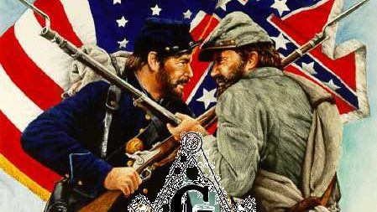
A Nation Divided
The United States Civil War
This Photo by Unknown Author is licensed under CC BY-NC-ND

Slide 2
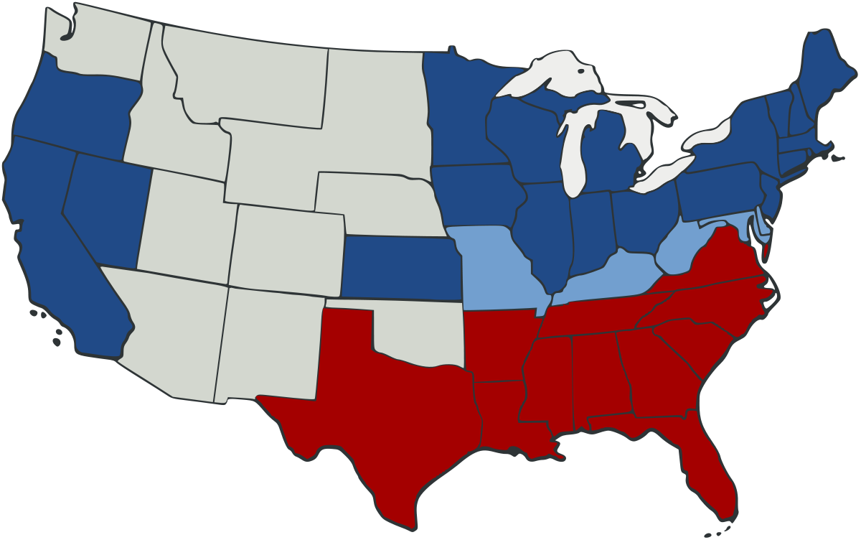
What is a civil war? A war between the citizens of a country
A war between citizens of the same country
This Photo by Unknown Author is licensed under CC BY-SA

Slide 3
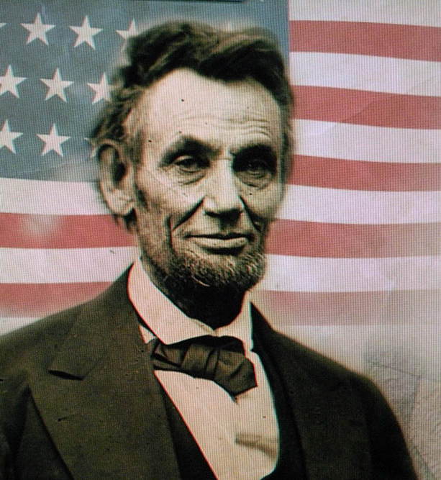
Important People
Abraham Lincoln was President of the Union (the North) during the war.
He wrote the Emancipation Proclamation, which freed the slaves.
He was assassinated. He was shot by John Wilks Booth at Ford’s Theater and died in a house across the street.
This Photo by Unknown Author is licensed under CC BY-NC-ND

Slide 4
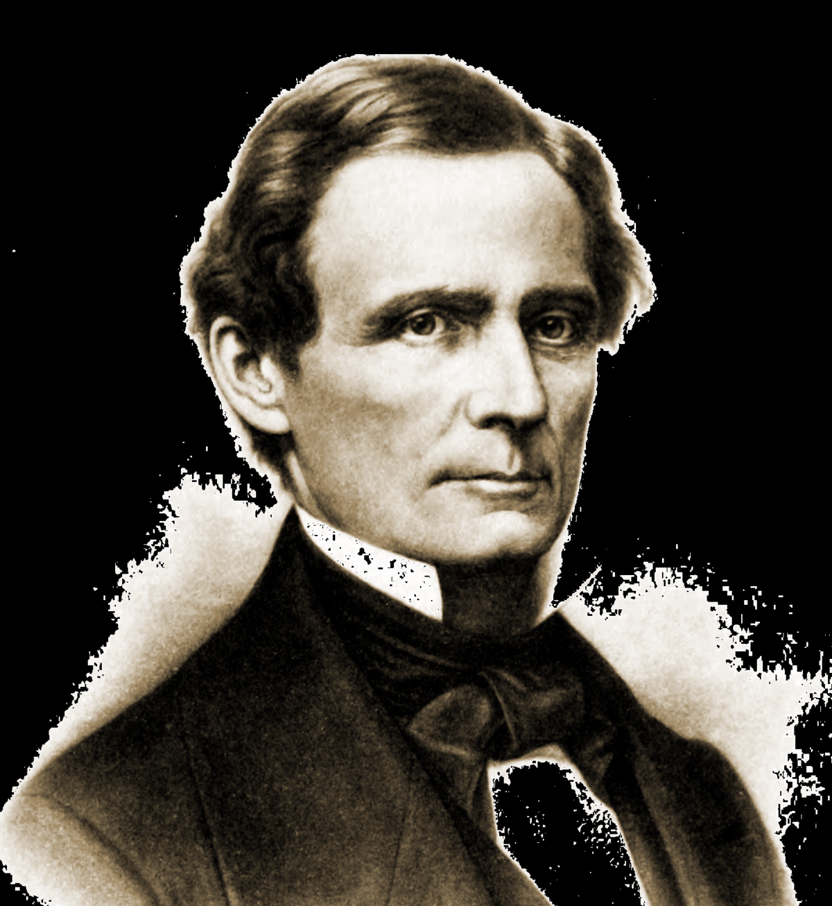
Important People
Jefferson Davis- First and only President of the Confederate States
This Photo by Unknown Author is licensed under CC BY-SA

Slide 5
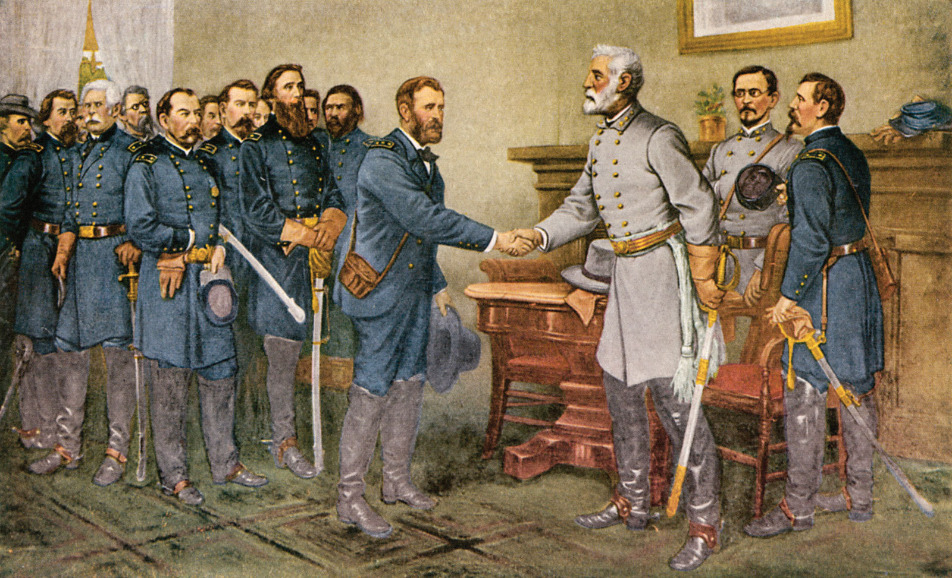
Important People
Ulysses S. Grant- commander of the Union (in blue)
Robert E. Lee- commander of the Confederate army (in grey)
Appomatox Court House – place where the South (Confederate) surrendered to the North (Union)
This Photo by Unknown Author is licensed under CC BY-SA

Slide 6
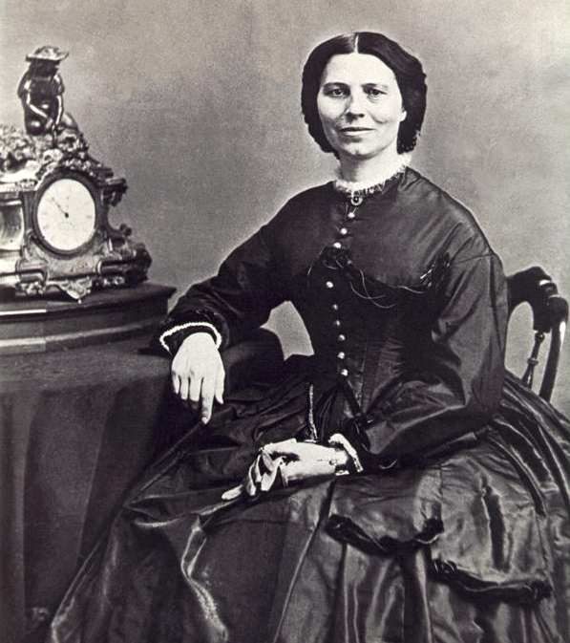
Important People
Clara Barton- Union army nurse. Started the American Red Cross after the War
This Photo by Unknown Author is licensed under CC BY-NC-ND

Slide 7
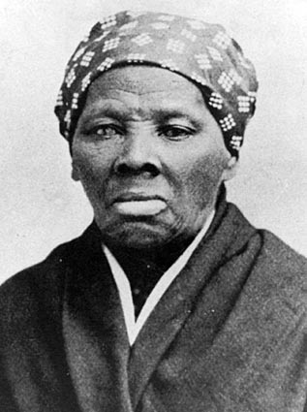
Important People
Harriet Tubman-led slaves to freedom using the Underground Railroad.
The Underground Railroad was NOT a real railroad. It was a network of secret routes and safe houses to help slaves reach the free North. There is a safe house here in Memphis, Slavehaven.
This Photo by Unknown Author is licensed under CC BY-NC-ND

Slide 8
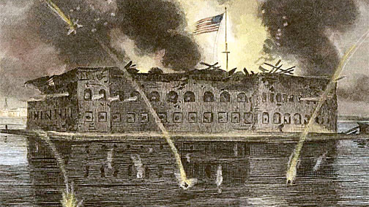
Fort Sumpter
An island in South Carolina. Place of the first battle of the Civil War.
This Photo by Unknown Author is licensed under CC BY-ND

