Slide 1
Readworks ELA Digital Suggested Tasks April 6-10, 2020
Grade 4: Sections 4-04, 4-05, 4-06

Slide 2
Alternate Suggested Activities:
If students do not have access to devices, choose one of the following:
Read for 30 minutes and write a summary about what was read in your own words.
Write journal entries about your thoughts, feelings or recreational, family or household activities that you have been involved in each day. Be sure to write or type the entries placing the date at the top of each entry.
These activities may be sent to your child’s Reading/Language Arts teacher.

Slide 3
Readworks Reminders:
Go to www.readworks.com
Read for pleasure for 30 minutes each day.
Complete 2 Readworks assignments this week on Monday and Tuesday and three 45 -minute sessions on I-Ready on Wednesday, Thursday and Friday.
f audio support is needed for your child to complete the assignments, please send an email to: prestonje@scsk12.org.

Slide 4
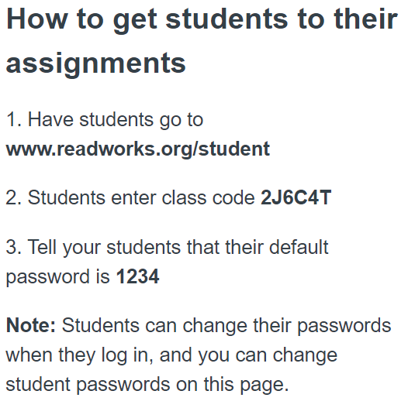
Readworks Instructions 4-04 Mr. Fant’s Homeroom

Slide 5
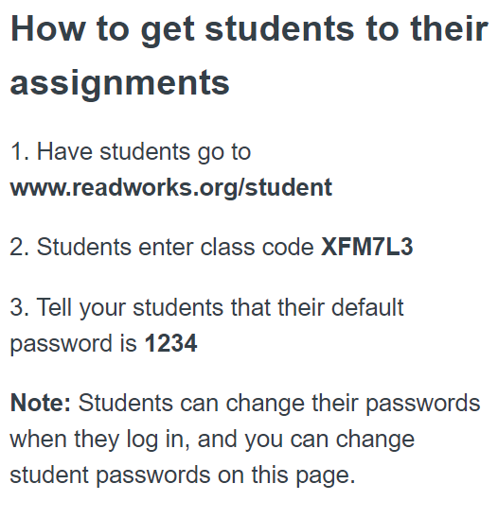
Readworks Instruction 4-05 Mrs. Preston’s Homeroom

Slide 6
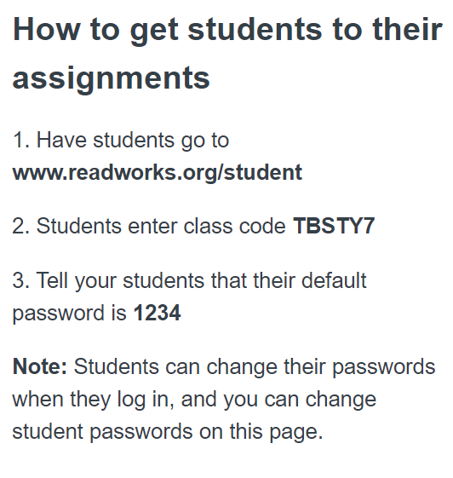
Readworks Instructions
4-06
Ms. McGarrity’s Homeroom

Slide 7
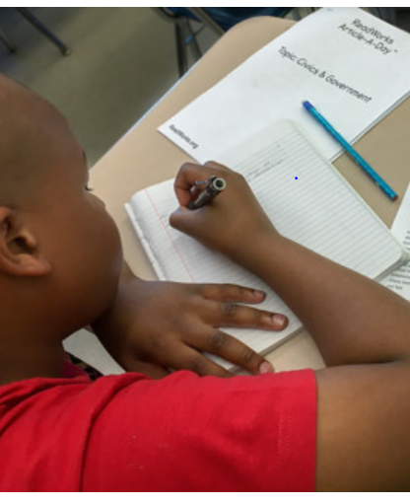
Happy Reading!

